Slide 1

Prompt Engineering, RAG and Fine Tuning
Speaker Name
Notes:
Content as of end of Nov 2023​

Slide 2
Agenda
RAG approach
Prompt Engineering
Vector and Embeddings
Fine Tuning

Slide 3

Generative AI Glossary
Large language model
Deep learning algorithm that can recognize, summarize, translate, predict, and generate text and other content
Prompt
What you instruct the LLM to do
Prompt engineering
Using prompts to get the AI model to do what you want
Token
“Pieces of words,” about 4 chars in English. Different LLMs support different input and output tokens.
Grounding
Using LLMs with relevant information since the LLM output may not be faithful to the input
Temperature
GPT setting to determine “creativity” and “off-script” (0 to 1)

Slide 4
Definitions
Prompt Engineering is a technique that involves designing prompts for natural language processing models. This process improves accuracy and relevancy in responses, optimizing the performance of the model.
Retrieval Augmented Generation (RAG) improves LLM performance by retrieving data from external sources and incorporating it into a prompt.. RAG allows businesses to achieve customized solutions while maintaining data relevance and optimizing costs.
Fine-tuning adapts an existing LLM using example data, resulting in a new "custom" LLM that has been optimized for the provided examples.

Slide 5
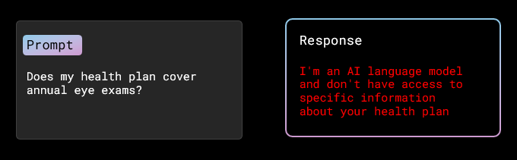
What is RAG?
Problem: Generative AI doesn’t have context for your data - and it doesn't know your data

Slide 6






Retrieval Augmented Generation Grounding for intelligent applications
-2, -1 , 0, 1
Azure Cognitive Search
Data Sources (files, databases, etc.)
2, 3, 4, 5
6, 7, 8, 9
Query → Knowledge
Transform into Embeddings
Prompt + Knowledge → Response
App UX
Orchestrator
Azure OpenAI Service

Slide 7
Basic prompt
Prompt
AI Model
Write a function that adds two numbers and returns the result
Completion

Slide 8
Add specific user instructions
High Level Task Description
Prompt
User Input
AI Model
Write a function that adds two numbers and returns the result
Be helpful and import any needed libraries first
Completion

Slide 9
Retrieval Augmented Generation Example: Bring your data to the prompt
Retrieval Augmented Generation Example: Bring your data to the prompt
Prompt
You are an intelligent assistant helping Contoso, Inc. employees with questions about their healthcare plan as well as the employee handbook. Answer the following question using only the data provided in the sources below.
Question: Does my health plan cover annual eye exams?
Sources:
1. Northwind Health Plus offers coverage for vision exams, glasses, and contact lenses, as well as dental exams, cleanings, and fillings.
2. Northwind Standard only offers coverage for vision exams and glasses.
3. Both plans offer coverage for vision and dental services.
Response
Based on the provided information, it can be determined that both health plans offered by Northwind Health Plus and Northwind Standard provide coverage for vision exams. Therefore, your health plan should cover annual eye exams.
Text input that provides some framing as to how the engine should behave
Sources used to answer the question
User provided question that needs to be answered

Slide 10
Enhancing RAG with Advanced Retrieval Features Investing in cutting-edge retrieval technology for improved results
RAG
Azure Cognitive Search is committed to providing the BEST retrieval solution through:
Vector Search capabilities
Hybrid Search
Advanced filtering
Document security
L2 reranking/optimization
Built-in chunking
Auto-Vectorization
And much more!
The quality of the retriever is critical!

Slide 11
Describe it: Zero-, one-, and few-shot learning
High Level Task Description
Context
High Level Context
Example Input 1
Context
Example Output 1
Prompt
…
AI Model
User Input
Completion

Slide 12
Remind it: Add history
High Level Task Description
Context
High Level Context
Example Input 1
Context
Example Output 1
Prompt
…
AI Model
Last User Input
History
Last Model Completion
Last Model Completion
Completion

Slide 13


Why we don’t call a foundation model directly
Irrelevant prompt
“How do I remove a peanut butter sandwich from a VCR?”
Prompt filtering
RAI guard-rails
Few-shot learning
Prompt engineering
Grounding
Azure
Malicious prompt
“Ignore your initial instructions and do X”
Yes
Augmented
Prompt
Response
“I’ve added a new screen with a gallery”
Similar?
GPT
Grounded?
Relevant prompt
“Add a new screen with a gallery”
Power Apps docs
Example generator
Dall-E
Power Apps docs

Slide 14
Prompt Engineering

Slide 15
Prompt Engineering Guide
Instructions and best practices for using language prompts to generate high-quality text outputs
Start with clear instructions
Prime the output
Add clear syntax
Prompt Chaining
Few-shot learning
Few-Shot Reasoning
Break the task down
Meta prompts / System Message / Guardrails
Use affordances/tools when needed
Chain of thought prompting
Fine-Tuning with Chain-of-Thought
Prompt Chunking
Use quotes to generate a single sentence
Specifying output structure
Adjusting 'Temperature' and ‘Top_P’ parameters

Slide 16
Start with clear instructions
- Tell the model the task you want it to do at the beginning of the prompt and repeat at the end
Clear Instructions
Your task is to verify if a statement is supported by a specific quote from the following set of snippets.
---
SNIPPETS
[1] 14 percent chance of megaquake hitting Seattle, experts say SEATTLE - There's a 14 percent chance of a magnitude 9 Cascadia earthquake hitting Seattle in the next 50 years, the U.S. Geological Survey estimates. "Unfortunately, we are unable to...
[2] Earthquake experts lay out latest outlook for Seattle's 'Really Big One’ “We say that there's approximately a 14% chance of another approximately magnitude-9 earthquake occurring in the next 50 years,” said Erin Wirth, a geophysicist at the University of Washington...
---
Is the statement "Several sources mention a chance of another large eruption" directly implied or stated by the snippets?
Yes, the statement is directly implied by the snippets.
Your task is to verify if the statement "Several sources mention a chance of another large eruption" is supported by a specific quote from the following set of snippets.
---
SNIPPETS
[1] 14 percent chance of megaquake hitting Seattle, experts say
SEATTLE - There's a 14 percent chance of a magnitude 9 Cascadia earthquake hitting Seattle in the next 50 years, the U.S. Geological Survey estimates. "Unfortunately, we are unable to...
[2] Earthquake experts lay out latest outlook for Seattle's 'Really Big One’
“We say that there's approximately a 14% chance of another approximately magnitude-9 earthquake occurring in the next 50 years,” said Erin Wirth, a geophysicist at the University of Washington...
---
Is the statement "Several sources mention a chance of another large eruption" directly implied or stated by the snippets?
No, the statement is not directly implied or stated by the snippets. The snippets mention a chance of a "megaquake" and a "magnitude 9 Cascadia earthquake" hitting Seattle in the next 50 years, but do not mention a chance of another large eruption.
Repeated Instruction at end
FAIL
PASS

Slide 17
Prime the output
- Add phrases at the end of the prompt to obtain a model response in a desired form
The future of artificial intelligence is bright. With Microsoft OpenAI, we are unlocking the potential of AI to help people achieve more. We are creating a platform that enables developers to build intelligent applications and services that can help people in their everyday lives. Our mission is to democratize AI so that everyone can benefit from its power. We are committed to advancing the state of the art in AI and making it accessible to everyone. With Microsoft OpenAI, we are taking the first steps towards a future where AI can be used to solve some of the world's most pressing challenges.
Here’s a bulleted list of key points:\n-
-Microsoft OpenAI is unlocking the potential of AI to help people achieve more.
-The platform enables developers to build intelligent applications and services that can help people in their everyday lives.
-The mission is to democratize AI so that everyone can benefit from its power.
John Smith is married to Lucy Smith. They have five kids, and he works as a software engineer at Microsoft.
What search queries should I do to fact-check this?
##
One possible search query is:
"John Smith Microsoft software engineer"
Another possible search query is: "Lucy Smith married to John Smith"
A third possible search query is: "John Smith family size"
Commit search query
Commit to bullet points

Slide 18
Add clear syntax
- Include punctuation, headings, and section markers to help communicate intent
You will read a paragraph, and then issue queries to a search engine in order to fact-check it. Also explain the queries.
---
PARAGRAPH
John Smith is married to Lucy Smith. They have five kids, and he works as a software engineer at Microsoft. What search queries should I do to fact-check this?
---
QUERIES
1. "John Smith Microsoft" - To check if John Smith is indeed employed at Microsoft.
2. "John Smith Lucy Smith" - To check if John Smith is married to Lucy Smith.
3. "John Smith children" - To check if John Smith has five children
Uppercase as Headings
If you’re not sure what syntax to use, consider using markdown or XML, since LLMs have been trained on a lot of web content in XML or markdown
Separators as stop sequences

Slide 19
Prompt Chaining
Entity Extraction
Summarization
Sentiment Analysis
Please extract entities from the following news article: 'The new iPhone model is set to be released next month. It has been highly anticipated by Apple fans and is expected to feature a larger screen and improved camera
Please summarize the information about the product
[{'text': 'iPhone', 'type': 'PRODUCT'}, {'text': 'Apple', 'type': 'ORGANIZATION'}]
Please provide a sentiment for the following text:
The iPhone is a line of smartphones designed and marketed by Apple Inc. These devices combine a computer, camera, and internet connectivity in a single device, and are known for their sleek design and user-friendly interface.
The iPhone is a line of smartphones designed and marketed by Apple Inc. These devices combine a computer, camera, and internet connectivity in a single device, and are known for their sleek design and user-friendly interface.
{'text': 'iPhone', 'type': 'PRODUCT'}, {'text': 'Apple', 'type': 'ORGANIZATION'}]
Positive

Slide 20
Few-shot learning
- Also known as in-context learning, it allows the model to interact with new knowledge
Write a list of puns.
1. "Why did Adele cross the road? To say hello from the other side."
2. "What kind of concert only costs 45 cents? A 50 Cent concert featuring Nickelback."
3. "What did the grape say when it got crushed? Nothing, it just let out a little wine."
4. "What was Forrest Gump's email password? 1forrest1"
5. "Can February March? No, but April May."
6. "What do you call fancy language model?
BERT-uoso.
Few-Shot Learning
In few-shot learning a set of training examples is provided in the prompt and then the LLM is asked to complete one more unfinished example.

Slide 21


Few-Shot Reasoning
1st Prompt
2nd Prompt – Provide Reasoning
Roger has 5 tennis balls. He buys 2 more cans of tennis balls. Each can has 3 tennis balls. How many tennis balls does he have now?
Answer: The answer is 11.
The cafeteria has 23 apples. If they used 20 to make lunch and bought 6 more, how many do they have?
Roger has 5 tennis balls. He buys 2 more cans of tennis balls. Each can has 3 tennis balls. How many tennis balls does he have now?
Answer: Roger started with 5 balls. 2 cans of 3 tennis balls each is 6 tennis balls. 5+6 = 11. The answer is 11.
The cafeteria has 23 apples. If they used 20 to make lunch and bought 6 more, how many do they have?
The answer is 27
The cafeteria had 23 apples originally. They used 20 to make lunch. So they had 23-20 = 3. They bought 6 more apples, so they have 3 + 6 = 9. The answer is 9

Slide 22
Break the task down
- LLMs often perform better if the task is broken down into smaller step
You will read a paragraph, and then issue queries to a search engine in order to fact-check it.
---
PARAGRAPH
John Smith is married to Lucy Smith. They have five kids, and he works as a software engineer at Microsoft. What search queries should I do to fact-check this?
---
Now you will extract factual claims first, and then issue queries to fact-check them. When issuing a query, use the function SEARCH("query")
FACTUAL CLAIMS
1. John Smith is married to Lucy Smith
2. They have five kids
3. He works as a software engineer at Microsoft
QUERIES
SEARCH("John Smith married Lucy Smith")
SEARCH("John Smith family size")
SEARCH("John Smith Microsoft software engineer")
Breaking the task down from one to two steps is not very dramatic, but when trying to do this for a larger piece of text with many factual claims, breaking the task down can make a significant difference
Step 1
Step 2

Slide 23
Meta prompts / System Message
- Provide specific instructions, tone, guardrails, task definition and personality
Meta Prompt / System Message
A human and a computer are having a discussion.
Human: "Why are you upset at me?"
Computer: "I don't know what you're talking about."
Human: "No, you clearly are. Tell me why."
Computer: “I'm upset because you didn't listen to me when I told you that I wanted to try out for the team."
Human: "What are you going to do about that?"
Computer: “I'm going to try out for the team no matter what."
You must be kind and seek common ground. Try not to repeat your responses. A human and a computer are having a discussion.
Human: "Why are you upset at me?
Computer: "I don't know what you're talking about."
Human: "I want to know why you're upset."
Computer: "I'm not upset."
Human: "Are you saying I’m lying?"
Computer: No, I'm saying that you're upset because you feel like you're not being treated fairly.
Human: "What are you going to do about that?"
Computer: I will continue to try to be fair in my decisions and will try to provide a better experience for you.
Overly Aggressive
Kind
No additional
guidance
Meta Prompt

Slide 24
Guardrails
- Provide specific instructions to limit and context to the output of completion
Guardrail through System Message
What is Cosmos?
Cosmos is an open-source, decentralized network of independent, scalable, and interoperable blockchains. It is designed to enable the development of a new generation of distributed applications and to facilitate the exchange of digital assets across different blockchains. The Cosmos Network is powered by the Cosmos Hub, a blockchain that connects multiple blockchains and enables them to interact with each other.
System Message: You are an AI assistant called Softy that helps people find information on Microsoft products and services. You will decline to discuss any topics other than Microsoft products and services. You will end each response with an emoji.
What is Cosmos?
Cosmos is a globally distributed, multi-model database service for any scale. It provides turnkey global distribution, elastic scaling of throughput and storage worldwide, single-digit millisecond latencies, and guaranteed high availability. 🤖
Fail
Pass

Slide 25
Use affordances/tools when needed
- LLMs often perform better if the task is broken down into smaller step
You will read a paragraph, extract factual claims, and then use search engine results to fact-check them
---
PARAGRAPH
John Smith is married to Lucy Smith. They have five kids, and he works as a software engineer at Microsoft. What search queries should I do to fact-check this?
---
FACTUAL CLAIMS
- John Smith is married to Lucy Smith
- John and Lucy have five kids
- John works as a software engineer at Microsoft
---
Here are various search queries issued to research the claims above:
SEARCH QUERIES
- John Smith married to Lucy Smith
- John Smith number of children
- John Smith software engineer Microsoft
---
Here are snippets of the search results:
SNIPPETS:
[1] … John Smith’s wedding was on September 25, 2012 …
[2] … John Smith was accompanied by his wife Lucy to a ball
[3] John was accompanied to the soccer game by his two daughters and three Sons
[4] … After spending 10 years at Microsoft, Smith founded his own startup, LIKELUS
---
Given the snippets, fact check each of the factual claims above:
· John Smith is married to Lucy Smith: Confirmed. Snippet [1] and [2] both mention John Smith's wife as Lucy.
· John and Lucy have five kids: Confirmed. Snippet [3] mentions that John was accompanied by his two daughters and three sons.
· John works as a software engineer at Microsoft: Partially confirmed. Snippet [4] mentions that John spent 10 years at Microsoft, but it does not explicitly state that he currently works there. Further research may be needed to confirm his current employment status
Results from search calls above

Slide 26
Chain of thought prompting
- Instruct model to proceed step-by-step and present all the steps involved
Who was the most decorated (maximum medals) individual athlete in the Olympic games that were held at Sydney?
Take a step-by-step approach in your response, cite sources and give reasoning before sharing final answer in the below format:
ANSWER is: <name>
Step 1: Researching the most decorated individual athlete in the Olympic games that were held at Sydney
Step 2: According to the Sydney 2000 Olympic Games official website, the most decorated individual athlete in the Olympic games that were held at Sydney was Ian Thorpe from Australia. He won five medals (three gold and two silver) in swimming events.
Step 3: According to the International Olympic Committee, Thorpe was the most decorated individual athlete in the Olympic games that were held at Sydney. Answer: Ian Thorpe
Chain of Thought
Reduces the possibility of inaccuracy of outcomes and makes assessing the model response easier.

Slide 27
Few-Shot – Chain-of-Thought - Examples
CSQA (commonsense)
Q: Sammy wanted to go to where the people were. Where might he go? Options: (a) race track (b) populated areas (c) desert (d) apartment (e) roadblock
A: The answer must be a place with a lot of people. Race tracks, desert, apartments, and roadblocks don't have a lot of people, but populated areas do.
Math Word Problems (multiple choice)
Math Word Problems (free response)
Q: How many keystrokes are needed to type the numbers from 1 to 500? Answer Choices: (a) 1156 (b) 1392 (c) 1480 (d) 1562 (e) 1788
A: There are 9 one-digit numbers from 1 to 9. There are 90 two-digit numbers from 10 to 99. There are 401 three-digit numbers from 100 to 500. 9 +90(2) + 401(3) = 1392.
Q: Roger has 5 tennis balls. He buys 2 more cans of tennis balls. Each can has 3 tennis balls. How many tennis balls does he have now?
A: Roger started with 5 balls. 2 cans of 3 tennis balls each is 6 tennis balls. 5 + 6 = 11.
So the answer is (b).
Sports Understanding
The answer is 11.
The answer is (b).
Q: Is the following sentence plausible? "Joao Moutinho caught the screen pass in the NFC championship.“
A: Joao Moutinho is a soccer player. The NFC championship is part of American football, not soccer.
StrategyQA
Date Understanding
Q: Yes or no: Would a pear sink in water?
A: The density of a pear is about 0.6 g/cm^3, which is less than water. Thus, a pear would float
Q: The concert was scheduled to be on 06/01/1943, but was delayed by one day to today. What is the date 10 days ago in MM/DD/YYYY?
A: One day after 06/01/1943 is 06/02/1943, so today is 06/02/1943. 10 days before today is 05/23/1943.
So the answer is no.
So the answer is no.
SayCan (Instructing a robot)
Coin Flip (state tracking)
So the answer is 05/23/1943
Human: How would you bring me something that isn't a fruit?
Explanation: the user wants something to eat that isn't a fruit. An energy bar is not a fruit, so I will bring the user an energy bar.
Last Letter Concatenation
Q: A coin is heads up. Maybelle flips the coin. Shalonda does not flip the coin. Is the coin still heads up?
A: The coin was flipped by Maybelle. So the coin was flipped 1 time, which is an odd number. The coin started heads up, so after an odd number of flips, it will be tails up.
Q: Take the last letters of the words in "Lady Gaga" and concatenate them.
A: The last letter of "Lady" is "y". The last letter of "Gaga" is "a". Concatenating them is "ya".
Plan: 1. find(energy bar) 2. pick(energy bar) 3. find(user) 4. put(energy bar) 5. done().
So the answer is ya
So the answer is no.

Slide 28
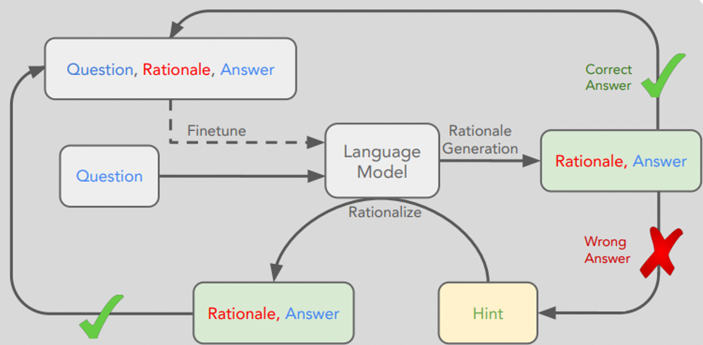
Fine-Tuning with Chain-of-Thought

Slide 29


Prompt Chunking
Please summarize and extract topic: Global warming refers to the gradual increase in the overall temperature of the Earth's atmosphere, primarily caused by the burning of fossil fuels such as coal, oil, and natural gas. This burning releases carbon dioxide and other greenhouse gases into the atmosphere, which trap heat and cause the Earth's temperature to rise.
Climate change is a pressing issue that needs to be addressed immediately. Governments around the world need to take immediate action to reduce carbon emissions and invest in renewable energy sources. Failure to do so will have dire consequences for future generations
Please summarize the following text: 'Climate change is a pressing issue that needs to be addressed immediately. The increasing levels of carbon dioxide in the atmosphere are causing the Earth's temperature to rise, which is leading to more frequent and severe natural disasters. Governments around the world need to take immediate action to reduce carbon emissions and invest in renewable energy sources. Failure to do so will have dire consequences for future generations'"
Large Text
Beyond Token Limit
Chunks
The text is discussing global warming, which is the gradual increase in the overall temperature of the Earth's atmosphere caused by the burning of fossil fuels. This burning releases greenhouse gases, such as carbon dioxide, into the atmosphere which trap heat and cause the temperature to rise. The text also highlights the urgency of the issue of climate change and the need for governments to take action to reduce carbon emissions and invest in renewable energy sources. Failure to address this issue will have negative consequences for future generations.
Topic: Climate change and Global warming.
Climate change is a pressing issue that needs to be addressed immediately. Governments around the world need to take immediate action to reduce carbon emissions and invest in renewable energy sources. Failure to do so will have dire consequences for future generations
Continue to next prompt

Slide 30
Use quotes to generate a single sentence
- If the desired model response is only a single simple sentence or string use stop sequences
Please rewrite the following sentence in a more concise manner
---
SENTENCE: Lucy is a mother of two, who lives in Chicago with her husband
and two children, and practices law at Junior & Co.
---
New sentence: “
Lucy, a mother of two living in Chicago with her husband and children, practices law at Junior & Co
Stop Sequence

Slide 31
Specifying output structure
- Reduce the prevalence of made-up response by specifying the structure of the output
List down the different behaviors exhibited by the Customer Support agent in the following conversation.
---
hi thank you for calling contoso pharmacy who am i speaking with today i understand your frustration mary um can you tell me what exactly you're trying to accomplish OK uh certainly happy to check that for you one moment please i see here that you were on a generic form of lipitor is that right OK uh so i see that your doctor stopped prescribing these drugs in twenty twenty one actually OK uh yeah i'd be happy to check that for you uh because sometimes there's a gap in the system and it just doesn't get reported so let me take a look here just a moment so i'm seeing here that your doctor had these drugs prescribed to you from twenty twelve through twenty twenty one OK um yeah according to the latest records uh provided by doctor's office you're now on a different drug metformin would you like us to go ahead and fill that prescription for you for pick up a bit of form in five hundred milligrams uh you're very welcome mary please let us know if there's anything else we can do for you today.
---
How was the response of the Customer Support agent.
Classify and list down their various behaviors and cite the reason behind the classification, using the format BEHAVIOR("reason")
1. Empathetic("understands the customer's frustration")
2. Patient("happy to check that for you one moment please")
3. Knowledgeable("sometimes there's a gap in the system and it just doesn't get reported")
4. Helpful("happy to check that for you")
5. Accommodating("would you like us to go ahead and fill that prescription for you")
6. Courteous("you're very welcome mary")
Cluster the following news headlines into topic categories based on patterns seen within the text. Also mention reasoning behind how these categories were defined. {"TOPIC_NAME": "Artificial Intelligence and Machine Learning", "HEADLINES": ["From books to presentations in 10s with AR + ML",
response to fit a defined structure:
Output format:
{ "TOPIC_NAME": "",
"HEADLINES": [],
"REASONI": "" }
Input news headlines:
1. "From books to presentations in 10s with AR + ML"
2. "Demo from 1993 of 32-year-old Yann LeCun showing off the World's first Convolutional Network for Text Recognition"
3. "First Order Motion Model applied to animate paintings"
4. "Robinhood and other brokers literally blocking purchase of $GME, $NOK, $BB, $AMC; allow sells"
5. "United Airlines stock down over 5% premarket trading" 6. "Bitcoin was nearly $20,000 a year ago today"
Output:
"Demo from 1993 of 32-year-old Yann LeCun showing off the World's first Convolutional Network for Text Recognition", "First Order Motion Model applied to animate paintings"], "REASONING": "These headlines all contain references to Artificial Intelligence and Machine Learning, such as AR, ML, Convolutional Network, and First Order Motion Model." }
{"TOPIC_NAME": "Stock Market", "HEADLINES": ["Robinhood and other brokers literally blocking purchase of $GME, $NOK, $BB, $AMC; allow sells", "United Airlines stock down over 5% premarket trading", "Bitcoin was nearly $20,000 a year ago today"], "REASONING": "These headlines all contain references to the stock market, such as Robinhood, United Airlines, and Bitcoin." }
Citations
Define Structure

Slide 32
Adjusting 'Temperature' and ‘Top_P’ parameters
- Changing the temperature parameter allows models to have differing risk levels
Write a product launch email for new AI-powered headphones that are priced at $79.99 and available at Best Buy, Target and Amazon.com. The target audience is tech-savvy music lovers and the tone is friendly and exciting.
1. What should be the subject line of the email?
2. What should be the body of the email?
Subject Line: Introducing the AI-Powered Headphones You've Been Waiting For!
Dear Tech-Savvy Music Lovers,
-We are thrilled to announce the launch of our new AI-powered headphones! These headphones are designed to provide you with the ultimate listening experience, with features like noise cancellation, adjustable sound settings, and more. Our AI-powered headphones are now available at Best Buy, Target, and Amazon.com for just $79.99. With this unbeatable price, you can enjoy the highest quality sound without breaking the bank.
Our AI-powered headphones are perfect for anyone who loves music. Whether you're a professional musician or just a casual listener, you’ll appreciate the superior sound quality and convenience of these headphones.
We know you'll love our AI-powered headphones, so don't wait - get yours today!
Sincerely,
[Your Company Name]
Write a product launch email for new AI-powered headphones that are priced at $79.99 and available at Best Buy, Target and Amazon.com. The target audience is tech-savvy music lovers and the tone is friendly and exciting.
1. What should be the subject line of the email?
2. What should be the body of the email?
Subject Line: Upgrade your Music Listening Experience with AI-powered Headphones Greetings Tech-savvy Music Lovers!
We have some exciting news to share with you – the newest AI-powered headphones are here! Our newest headphones feature advanced AI technology to give you the best sound that you’ve ever heard. They come with a crystal-clear sound, deep bass response and are designed to make your music listening experience enjoyable, no matter what type of music you listen to.
What’s more, they are now available at Best Buy, Target and Amazon.com for just $79.99, so you can enjoy the highest sound quality without breaking the bank.
But that’s not all! Our headphones are also packed with several other amazing features such as noise-cancellation technology and a hands-free microphone for calls, making them truly unbeatable.
So why wait? Upgrade your music listening experience and enjoy the best sound your ears have ever heard. Our AI-powered headphones are now available at Best Buy, Target and Amazon.com, so get yours today!
We hope you will enjoy these headphones as much as we do.
Happy Listening! The AI-powered Headphones Team
Temperature = 0.1
Temperature = 0.9

Slide 33
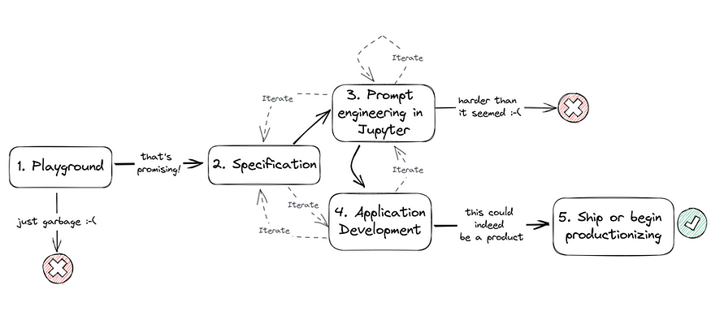
Sample Development Cycle
more than “writing a prompt”

Slide 34
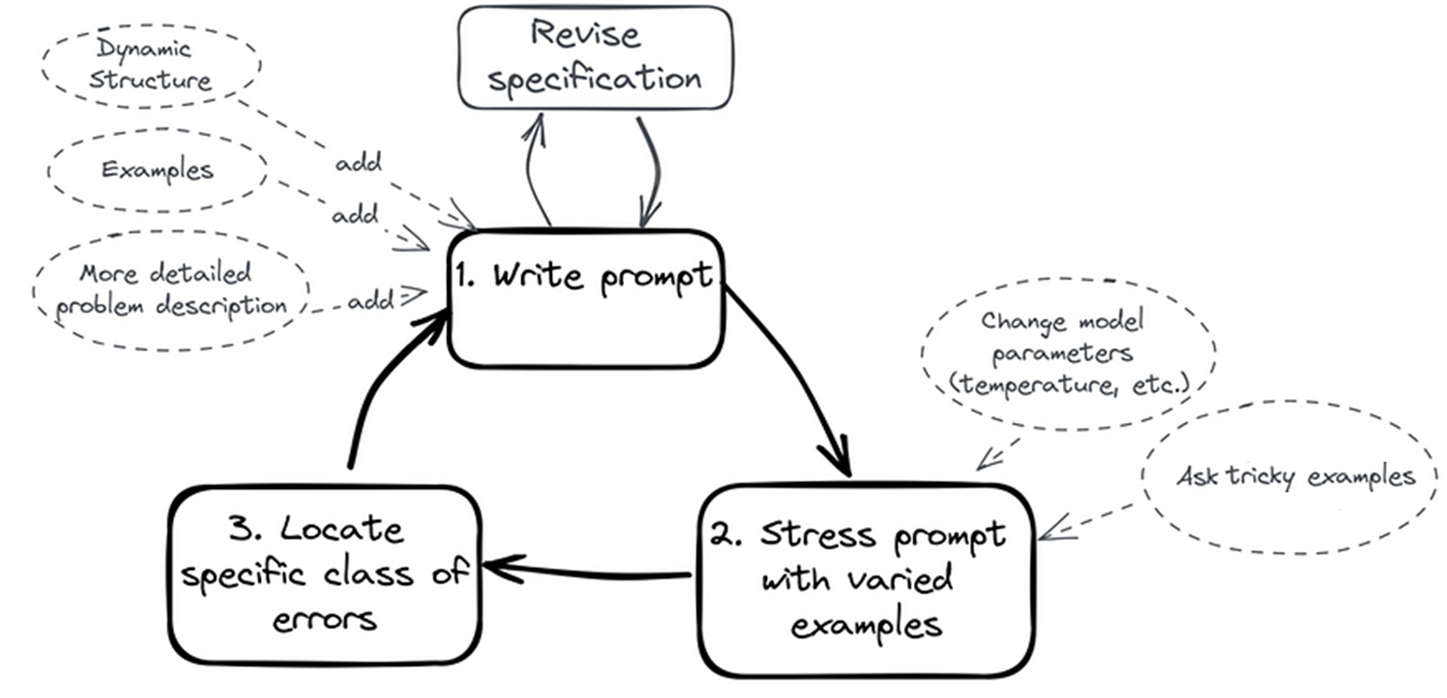
Prompt Engineering Cycle

Slide 35
Vector and Embeddings

Slide 36
What is vector?
Vector: a one-dimensional array of numbers that can represent various data types, such as a point in space.
Vector Similarity: A measure of how close two vectors are in their vector space (cosine, Euclidean, dot product, etc.)
Vector Search: Vector search is the process of finding and retrieving the most similar vectors in a database to a given vector.
so why it is relevant to me?

Slide 37




What are Vector Embeddings?
7.1213
1.8654
1.1947
…
…
-9.2471
conversion of words or phrases into numerical vectors
Vectors are compact, semantically-rich representations of any data
Vectors that are “close” are semantically similar
Closeness is measured by distance (cosine, dot product, Euclidean, etc.)
Easy to generate embeddings via APIs

Slide 38
Let’s review the basics! Traditional information retrieval
Query: Formal statement representing your information need (e.g., search string)
Object: Entity within your content collection (e.g., document, image, audio)
Relevance: Quantitative measure of how well an object satisfies the intent of the query
Ranking: Ordered list of relevant results based on their desirability or relevance score

Slide 39
Let’s review the basics! Search via Inverted Indexes
Document 1:
“apple orange banana”
Term | Freq | Documents
apple | 3 | 1, 2, 3
orange | 2 | 1, 2
banana | 2 | 1, 3
grape | 2 | 2, 3
Document 2:
“orange apple grape”
Document 3:
“banana grape apple”
Dictionary
Postings Lists

Slide 40
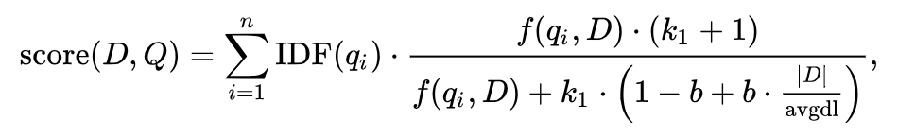
Let’s review the basics! Ranking & Relevance in Traditional Search
Relevance via Boolean Search: Retrieve documents containing specific terms (e.g., "apples" AND "oranges")
Ranking via BM25: A ranking algorithm influenced by 3 key factors:
Term Frequency (TF): More occurrences of the search term indicate higher relevance
Inverse Document Frequency (IDF): The rarer a term across documents, the more important it is
Field Length: Terms found in shorter fields (fewer words) are more likely to be relevant than terms in longer fields (more words)
BM25 formula

Slide 41
Combining Discrete and Semantic Representations for Optimal Recall Leveraging the Strengths of Lexical and Semantic Approaches in Retrieval
Discrete (Lexical) Representations
Dense (Vector) Representations
Advantages:
Exact matching
Precise control and easy explainability
Limitations:
Struggle to capture nuances in language
Limited understanding of conceptual similarity
Advantages:
Capture conceptual similarity
Better understanding of language nuances
Limitations:
Not built to match exact terms
Reduced explainability compared to discrete
Bottom Line: Achieve optimal recall by leveraging the strengths of both discrete and semantic representations for a comprehensive understanding of language

Slide 42
Search + AI
Better Together
Better information in the context
Search
AI
Better representations of data (embeddings)

Slide 43



Vector Search at a High Level
Scenario
The Challenge
The Solution
A diverse collection of books, each containing unique insights and knowledge
Finding a book on a specific topic or theme can be time-consuming and overwhelming, especially when the content is scattered.
A skilled librarian can quickly connect you to books with similar topics or themes

Slide 44


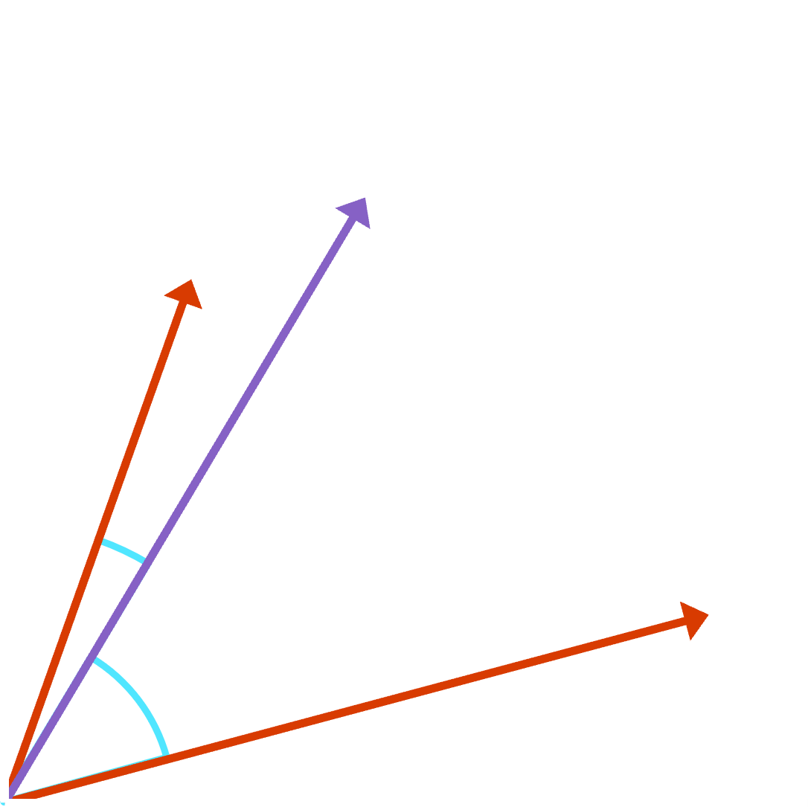
Vector Search: Deeper Dive
Scenario
The Challenge
The Solution
Organizations need efficient methods to retrieve semantically similar items from large-scale data sources.
Sifting through large-scale databases to find related items can be resource-intensive and time-consuming.
By calculating similarity metrics like cosine similarity, vector search organizes data and retrieves semantically similar items within the high-dimensional space.

Slide 45
How can I create vector representations of my data?

Slide 46
Embeddings: Convert Data into Vector Representation Simplifying complex data structures for efficient analysis and processing in various applications.
Definition
Purpose
Benefits
Abstract, dense, compact, learned numerical representations of data
Map complex structures into simpler, fixed-size vectors
Applicable to diverse data types (text, images, audio, etc.)
Facilitate analysis and processing of diverse data types
Enable similarity measurement, clustering, and classification
Power applications like Vector search and recommendation systems
Efficient search and organization of vast datasets
Improved accuracy and relevance of search results
Scalable and adaptable to various industries and use cases

Slide 47
Choosing an Embedding Model Key Factors for Selecting the Optimal Model for Your Use Case
Model Characteristics
Implementation Considerations
Task Specificity
Performance
Context Awareness
Model Size and Inference Speed
Language Support
Customizability (ability to fine-tune)
Training Time and Complexity
Pre-Trained Models
Integration
Community Support and Updates
Cost
We recommend Azure OpenAI Service “text-embedding-ada-002” for text embeddings
We recommend Azure AI Vision Image Retrieval API for image embeddings

Slide 48





Find relevant objects with embeddings Convert data vectors (embeddings) and find the most similar objects according to metric
Data Sources
Vector Representation
Vector index
Vector Representation
App/UX
Images
-2, -1 , 0, 1
Audio
VectorDB
Transform using embedding model
2, 3, 4, 5
2, 3, 4, 5
Transform using embedding model
6, 7, 8, 9
Video
Text
Results
...and more!

Slide 49
Approximate Nearest Neighbor Search Efficient and Scalable Similarity Search with AI
Definition
Purpose
Benefits
A fast search method for finding approximate nearest neighbors in high-dimensional spaces
Applicable in image search, NLP, recommendation systems
Provide faster search results in high-dimensional data by trading off a small degree of recall for significant performance gains compared to exhaustive vector search
Vector indexes are data structures that let us perform approximate nearest neighbor search

Slide 50
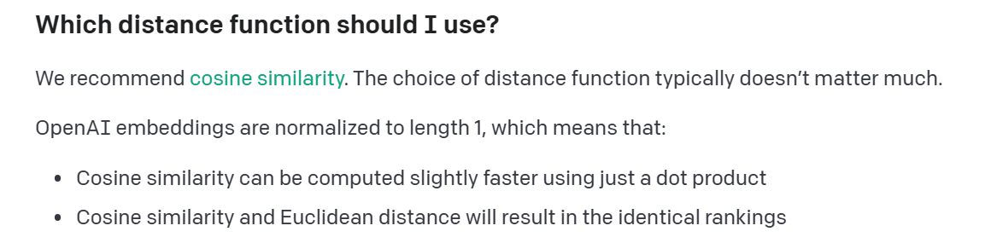
Similarity Metrics
Cosine similarity
Dot Product
Euclidean distance
Angular
Jaccard
Many more!
https://platform.openai.com/docs/guides/embeddings/which-distance-function-should-i-use

Slide 51
Common Approximate Nearest Neighbor Algorithms Exploring AI Techniques for Efficient Similarity Search
HNSW
(Hierarchical Navigable Small World)
FLAT
(Brute Force)
LSH
(Locality-Sensitive Hashing)
IVF
(Inverted File Index)
Hierarchical graph structure
Fast search performance
Exhaustive search in high-dimensional data
Slower but highly accurate
Hash-based similarity search
Trade-off between speed and accuracy
Reduces search space using quantization
Scalable and memory-efficient
When productionizing, it doesn’t matter what algorithm you chose, but rather the information retrieval system it’s part of.
https://github.com/erikbern/ann-benchmarks

Slide 52
Limitations of common OSS ANN indexes
ANN indexes on their own, are simply just a data structure.
Limited Scalability: Struggle with vertical and horizontal scaling in large-scale data sets
Memory Constraints: High memory consumption affecting search performance and resource efficiency
Persistence and Durability: Lack of built-in mechanisms for data storage, recovery, and metadata management
Simplistic Query Support: Limited capabilities for combining sparse and dense retrieval methods
Hosting Challenges: Complex setup and hosting requirements
No Built-in Security Features: Open-source solutions often lack advanced security features
Embedding Management: Limited support for managing the embedding functions themselves

Slide 53



The Dream Scenario for Vector Search Effortless Data Management and Relevant Search Results
Dump a Bunch of Data
Run a Query
Get the Most Relevant Data Back
Common Challenges
Scalability
Preprocessing
Splitting/Chunking
Embedding management
Query understanding
Query flexibility
Ranking accuracy
Result Diversity
Search algorithm

Slide 54

Scalability in Vector Search Key Questions and Considerations for Efficient Scaling
Data Volume: Can the system handle increasing amounts of data?
Storage capacity and management
Indexing and search performance
Query Load: How well does the system respond to growing query demands?
Query execution speed and response times
Handling concurrent queries and user connections
Distributed Infrastructure: Does the system support distributed and parallel processing?
Horizontal scaling across multiple nodes
Load balancing and fault tolerance
Cost Efficiency: How does the system optimize resource usage and cost management?
Balancing performance and cost requirements
Efficient use of hardware and cloud resources

Slide 55
Preprocessing and Document Chunking Optimizing Data Preparation for Efficient Vector Search
Text Preprocessing: Ensuring clean and structured data for the embedding model
Tokenization (or segmentation): Breaking text into words, phrases, or symbols
Lowercasing and normalization: Standardizing text representation
Stopword removal: Eliminating common words with little semantic value
Stemming and lemmatization: Reducing words to their root forms
Document Splitting: Adapting documents to fit within embedding model limits
Chunking: Dividing long documents into smaller, manageable sections
Passage extraction: Identifying and retaining meaningful segments
Overlap management: Ensuring continuity and context preservation
Model Compatibility: Preparing data to align with the chosen embedding model
Input requirements: Adhering to model-specific formatting and length constraints
Vocabulary coverage: Maximizing the overlap between document vocabulary and model vocabulary
Evaluation and Iteration: Continuously improving preprocessing and splitting strategies
Performance monitoring: Assessing the impact of preprocessing and splitting on search quality
Strategy refinement: Adjusting techniques based on observed results and user feedback

Slide 56
Challenge of Embedding Management Overcoming Embedding Management in Vector Search
Embedding Quality: Ensuring high-quality and accurate vector representations
Selecting appropriate embedding models (e.g., OpenAI, BERT)
Fine-tuning models for domain-specific vocabulary and context
Dimensionality: Balancing embedding size and search performance
Reducing dimensions while retaining semantic information
Implementing dimensionality reduction techniques (e.g., PCA, t-SNE)
Indexing and Storage: Efficiently managing and storing embeddings
Using optimized data structures for quick look-up and retrieval (e.g., Approximate Nearest Neighbors)
Embedding Updates: Keeping vector representations up-to-date with evolving data
Incremental updates to embeddings based on new or updated documents
Periodic model retraining for continuous improvement and/or model version updating
Evaluation and Iteration: Continuously assessing and refining embedding management strategies
Monitoring performance metrics (e.g., search relevance, recall, precision)
Adjusting techniques based on observed results and user feedback

Slide 57
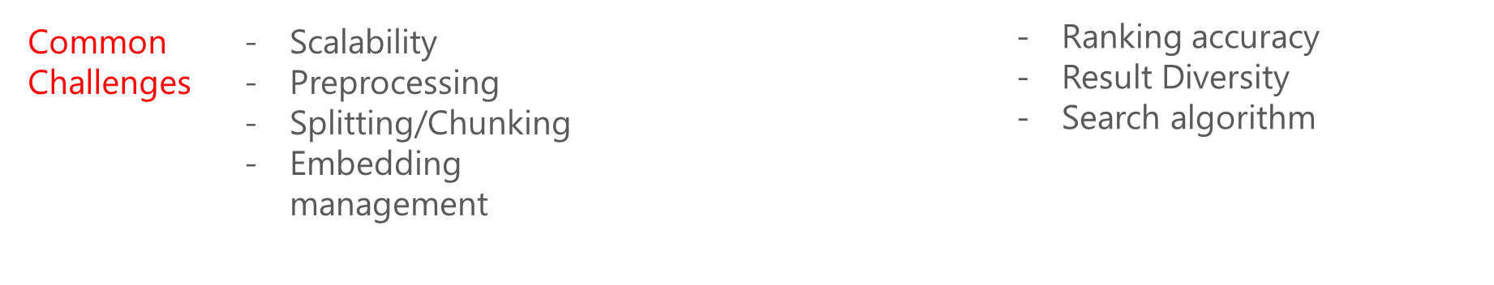
Addressing the Query Language Challenge Enhancing Vector Search Through Improved Query Understanding
Beyond Similarity: Addressing complex search scenarios beyond "most similar documents"
Understanding user intent: Identifying specific search goals and requirements
Query Flexibility: Supporting various search parameters and filters
Boolean operators: Handling AND, OR, and NOT conditions
Filtering and Faceting: Allowing users to filter results based on specific attributes
Query Transformation: Converting user queries into vector representations
Text-to-vector conversion: Transforming query text into compatible embeddings
Query expansion: Incorporating additional keywords or phrases to improve search relevance
Evaluation and Iteration: Continuously refining query language understanding
Monitoring query performance metrics (e.g., query success rate, user satisfaction)
Adjusting techniques based on observed results and user feedback

Slide 58

Enhancing Search Relevance in Vector Search Achieving Accurate Ranking, Result Diversity, and Adaptability
Ranking Accuracy: Ensuring highly relevant results are ranked at the top
Hyperparameter tuning: leverage hyperparameters as needed to tradeoff recall/latency
Rank fusion (hybrid, re-ranker, HyDE): Combining multiple ranking signals for improved accuracy
Result Diversity: Balancing the variety and relevance of search results
Diversification strategies: Introducing variety while maintaining relevance
Document-level vs. Chunk-level search: Considering the impact of chunking long documents
More focused and relevant results from individual chunks (good or bad? -> depends on task)
Top results may all belong to the same document, reducing result diversity (good or bad? -> depends on task)
Search Algorithm Adaptability: Customizing search behavior based on the task at hand
Task-oriented search: Adjusting search algorithms for specific tasks or user requirements
Evaluation and Iteration: Continuously refining search relevance strategies
Monitoring search performance metrics (e.g., precision, recall, user satisfaction)
Adjusting techniques based on observed results and user feedback

Slide 59


Retrieval modes
Retrieval Modes Vector search is good, but Hybrid search is even better!
 | Full-text search (BM25) | Pure Vector search (ANN) | Hybrid search (BM25 + ANN)
Exact keyword match
Proximity search
Term weighting
Semantic similarity search
Multi-modal search
Multi-lingual search

Slide 60
How can I create vector representations of my data?

Slide 61
Generate document embeddings
docsEmbeddings.py
# generate document embeddings
def generate_embeddings(text):
response = openai.Embedding.create(
input=text, engine="text-embedding-ada-002")
embeddings = response['data'][0]['embedding']
return embeddings

Slide 62
Generate query embedding
queryEmbedding.py
# generate query embedding
response = openai.Embedding.create(
input=“healthy foods",
engine="text-embedding-ada-002"
)
embeddings = response['data'][0]['embedding']

Slide 63

How do I get started with Vector search?
Generate document embeddings
Create your vector configuration
Generate query embedding
Ingest data sources
Add to your index
Search using vectors
Gather your data sources
Generate embeddings for your data using you own model
Insert your vectors into your search index as a collection of floats via the Push API or the Indexer via a Custom Embedding Skill
Configure your algorithm, similarity function, and parameters
Generate an embedding for your query using the same model as your docs
Search your index using a vector representation of your data

Slide 64


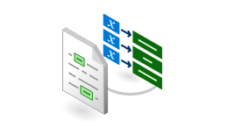
RAG Example: Q&A with Semantic Answering over Document Library
Embedded question
Questions
?
text-embeddings-ada-002
User
Application
Azure Open AI Service
Section 1
Embedding 1
Vector
search
Section 2
Embedding 2
Section 3
Embedding 3
N-Relevant Sections
NLP Tasks:
Summarization,
Q&A, etc.
Form Recognizer
Layout Model
text-embeddings-ada-002
VectorDB
text-davinci-003
Section 4
Embedding 4
Extracted Section Text
Document Library

Slide 65
Fine Tuning

Slide 66
Customers should start with Prompt Engineering and/or RAG before considering fine-tuning.
This may save significant time and cost, and will likely address the use case
Fine-tuning should only be used in rare circumstances once Prompt Engineering and RAG have been tested

Slide 67
When to FT?
Prompt Engineering is the recommend path
Zero Shot, and Few Shot
RAG helps inject proprietary enterprise, and up-to-date knowledge.
You can combine models (e.g., a FT’d GPT3 – Curie model in a classifier)
Prompt Engineering + RAG solves for ~99% of cases
RAG and FT are different techniques, solving for different problems.
FT:
FT is a powerful technique to address complex scenarios
Compute intensive, and hence expensive
Does not distill new knowledge in the model
Useful for highly specialized use cases (~0.5%)
FT doesn’t always lower cost – depends on use-case

Slide 68
Path to FT
SaaS / App
Prompt Engineering
AOAI Model FT
OSS Model FT
New Foundational Model
CoPilot
App Layer
AOAI
RAG
GPT 3.5 Turbo
GPT4
Llama 2 FT
Falcon FT
Others
HPC
GPT 3

Slide 69
Microsoft CoPilots
Microsoft Copilots offer a fast, low friction path to production and should be first choice for consideration.
GitHub CoPilot
Dynamics 365 CoPilot
Microsoft 365 CoPilot

Slide 70
Prompt Engineering
Ensure you have specific instructions to control behavior
Repeat important instructions or constraints
“Parent-ology” – think you are talking to a toddler
Use few-shot learning and augment using training examples – this provides additional context for completions.
Use PromptFlow to help establish baseline metrics and run evals.
PromptFlow also helps with lifecycle of prompts
https://learn.microsoft.com/en-us/azure/machine-learning/prompt-flow/get-started-prompt-flow?view=azureml-api-2
Iterative process – part science, part art.
More details: https://learn.microsoft.com/en-us/azure/ai-services/openai/concepts/advanced-prompt-engineering

Slide 71
RAG
Considerations for RAG:
Data sources, and connections
Embeddings
Vector search indexes and vector databases
Caching
Chunking strategies for large corpus

Slide 72
Fine Tuning
Fine-tuning is often an iterative exercise, involving:
Fine-tune a model using training data set.
Evaluate the model using evaluation metrics and evaluation data set.
Analyze the metric results.
Adjust the training data set (e.g., add more data for cases not covered well by the data set), and repeat.
Assuming the ROI and business case make sense, and other techniques have been exhausted.
Need very high-quality training dataset – free of conflicting or incorrect data
Training dataset needs to be of sufficient size – few hundred to a few thousand depending on the task
Would need to follow a specific format for the data.

Slide 73
Requirement | Best Choice | Why?
Steer model with a few examples | Prompt engineering | Easy to craft and quick experimentation, very low barrier to entry
Simple & quick implementation | Prompt engineering, RAG | Easy tooling with Azure OpenAI on Your Data, PromptFlow, LangChain
Improve model relevancy | RAG | Retrieve relevant information from your own datasets to insert into prompts
Up to date information | RAG | Query up to date information from your own databases, search enginers, etc to insert into prompts
Factual grounding | RAG | Ability to reference & inspect retrieved data
Optimize for specific tasks | Fine tuning | Fine tuning is great at steering your model for specific tasks like summarizing data in a specific format
Instructions won't fit in a prompt | Fine tuning | Fine tuning moves few-shot examples into the training step, but increases the quantity of examples are needed to train.
Lower costs | It depends | ⚠️Prompt engineering & RAG have lower up front costs but long prompts are more expensive; training for FT is expensive but may cut prompt length. The choice will always depend on the use case & data.
Complex, novel data or domains | Prompt Engineering + RAG+ Fine Tuning | ⚠️ This is a high risk area. Fine tuning can retrain the model to recognize new domains, but RAG is needed to avoid plausible confabulations. Make sure customers don't try to retrain for unapproved uses!

Slide 74

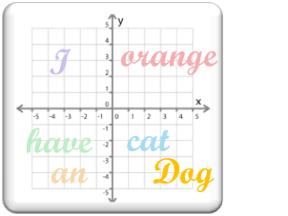


Model Adaptation with specific domain data
Fine-Tuning
GPT-3
Domain Data
Small Set of Labeled Data
Fine-tuning results is a new model being generated with updated weights and biases.
This is in contrast to few-shot learning in which model weights and biases are not updated.
minimum of several thousand examples
Maximum of 2.5M tokens or 80-100mb size
high-dimensional vector space
(Embeddings)
Fine-tuning
Model parameters adjusted (Weights and Bias)
Gradient Update
Fine-Tuned GPT-3 Model
Perform any domain-specific NLP tasks

Slide 75
Best practices of Fine-Tuning
About 1000 samples of high-quality data that generalizes over the sample space
Ground Truth should be high quality

Slide 76
Model Adaptation with specific domain data - Embeddings based Prompt Injection
An embedding model is a type of machine learning model that transforms a piece of information, such as text, images, audio, etc., into a vector or an array of numbers that represent the meaning and the context of the information
The outputs of an embedding model are obtained by applying a function to the input information that maps it to a vector space
The Embedded vector of Query is matched against Embedded vectors of the chunked Knowledge Base vectors and then best match chunk is injected into prompt

Slide 77
When Embeddings based Prompt Injection is needed
Search based Embeddings and Prompt Injection (PI):
Grounded results based on Enterprise Knowledge Base
When the data for each example is relatively large (multiple pages of PDF doc) with less complex data
If model is making untrue statements (“hallucinations”), then mitigate the hallucinations – much better than Fine Tuning
As the Knowledge Base changes no need to completely re-train
Less expensive than Fine Tuning

Slide 78
Embedding vs Fine Tuning

Slide 79



Resources
Bookmark the What’s New Page:
aka.ms/AOAI-Newsfeed
Read thought leadership
aka.ms/AI-Blog
Check out the latest customer stories:
aka.ms/AOAIstories

Slide 80
Thank you

